Slide 2
Welcome to the ICOS Science Conference!
The ICOS Science Conference 2024 will be held in Versailles, France and online on 10th -12th September 2024.
The event brings together scientists from around the world to present their latest research, engage with their peers and make new connections.
Following the success of our first hybrid ICOS Science Conference in 2022, this year’s conference will also be a fully hybrid event, allowing participation from anywhere in the world.

Slide 3
Call for Abstracts & Registration
Call for Abstracts is open between 1st February 2024 and 8th April 2024.
Deadline for Abstracts: Monday 8th April 13.00 CET.
Registration begins on 1st May and stays open until the event (speaker registration deadline closes earlier)
Registration fees for on-site and online participation will be announced on the conference website at a closer date

Slide 4
Sessions
The sessions chosen for the ICOS Science Conference 2024 reflect some highly topical issues as well as emerging trends within the fields of atmospheric, ecosystem, and ocean sciences.
On top of reflecting ICOS’s three domains, the sessions incorporate broader themes such as climate services and science communication.
See the list of sessions: icos-ri.eu/sc24

Slide 5
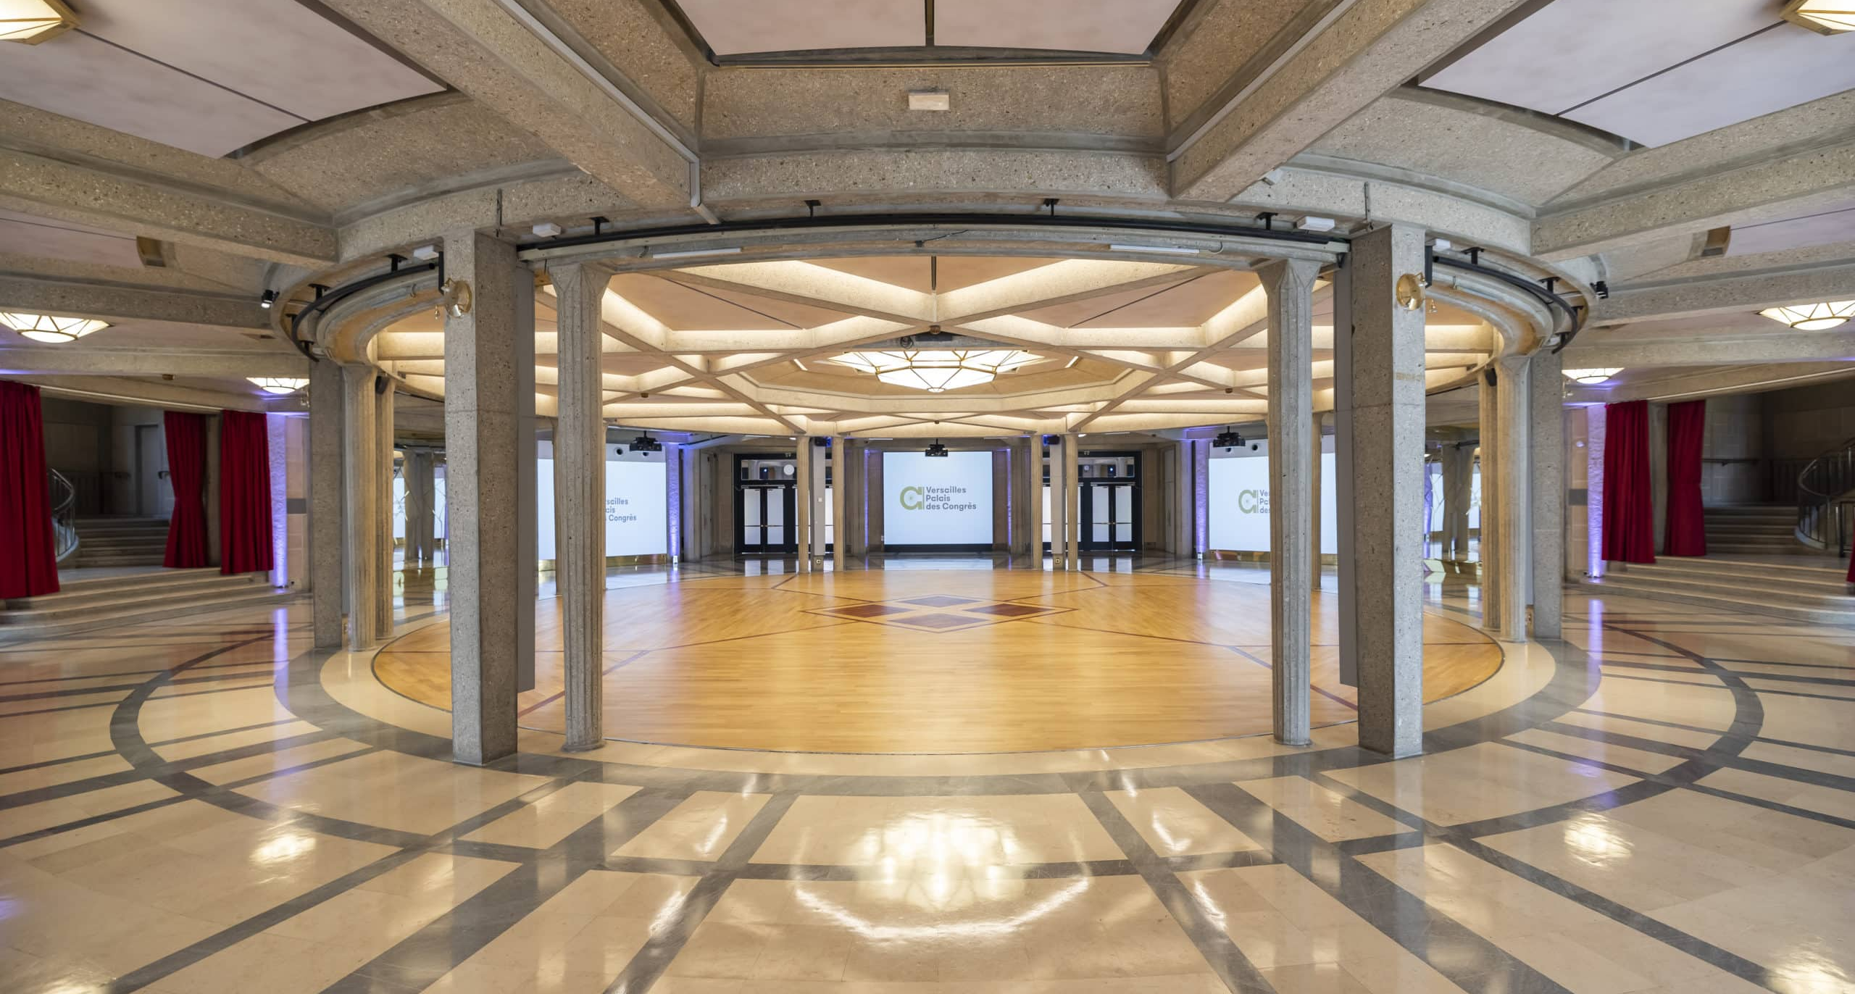
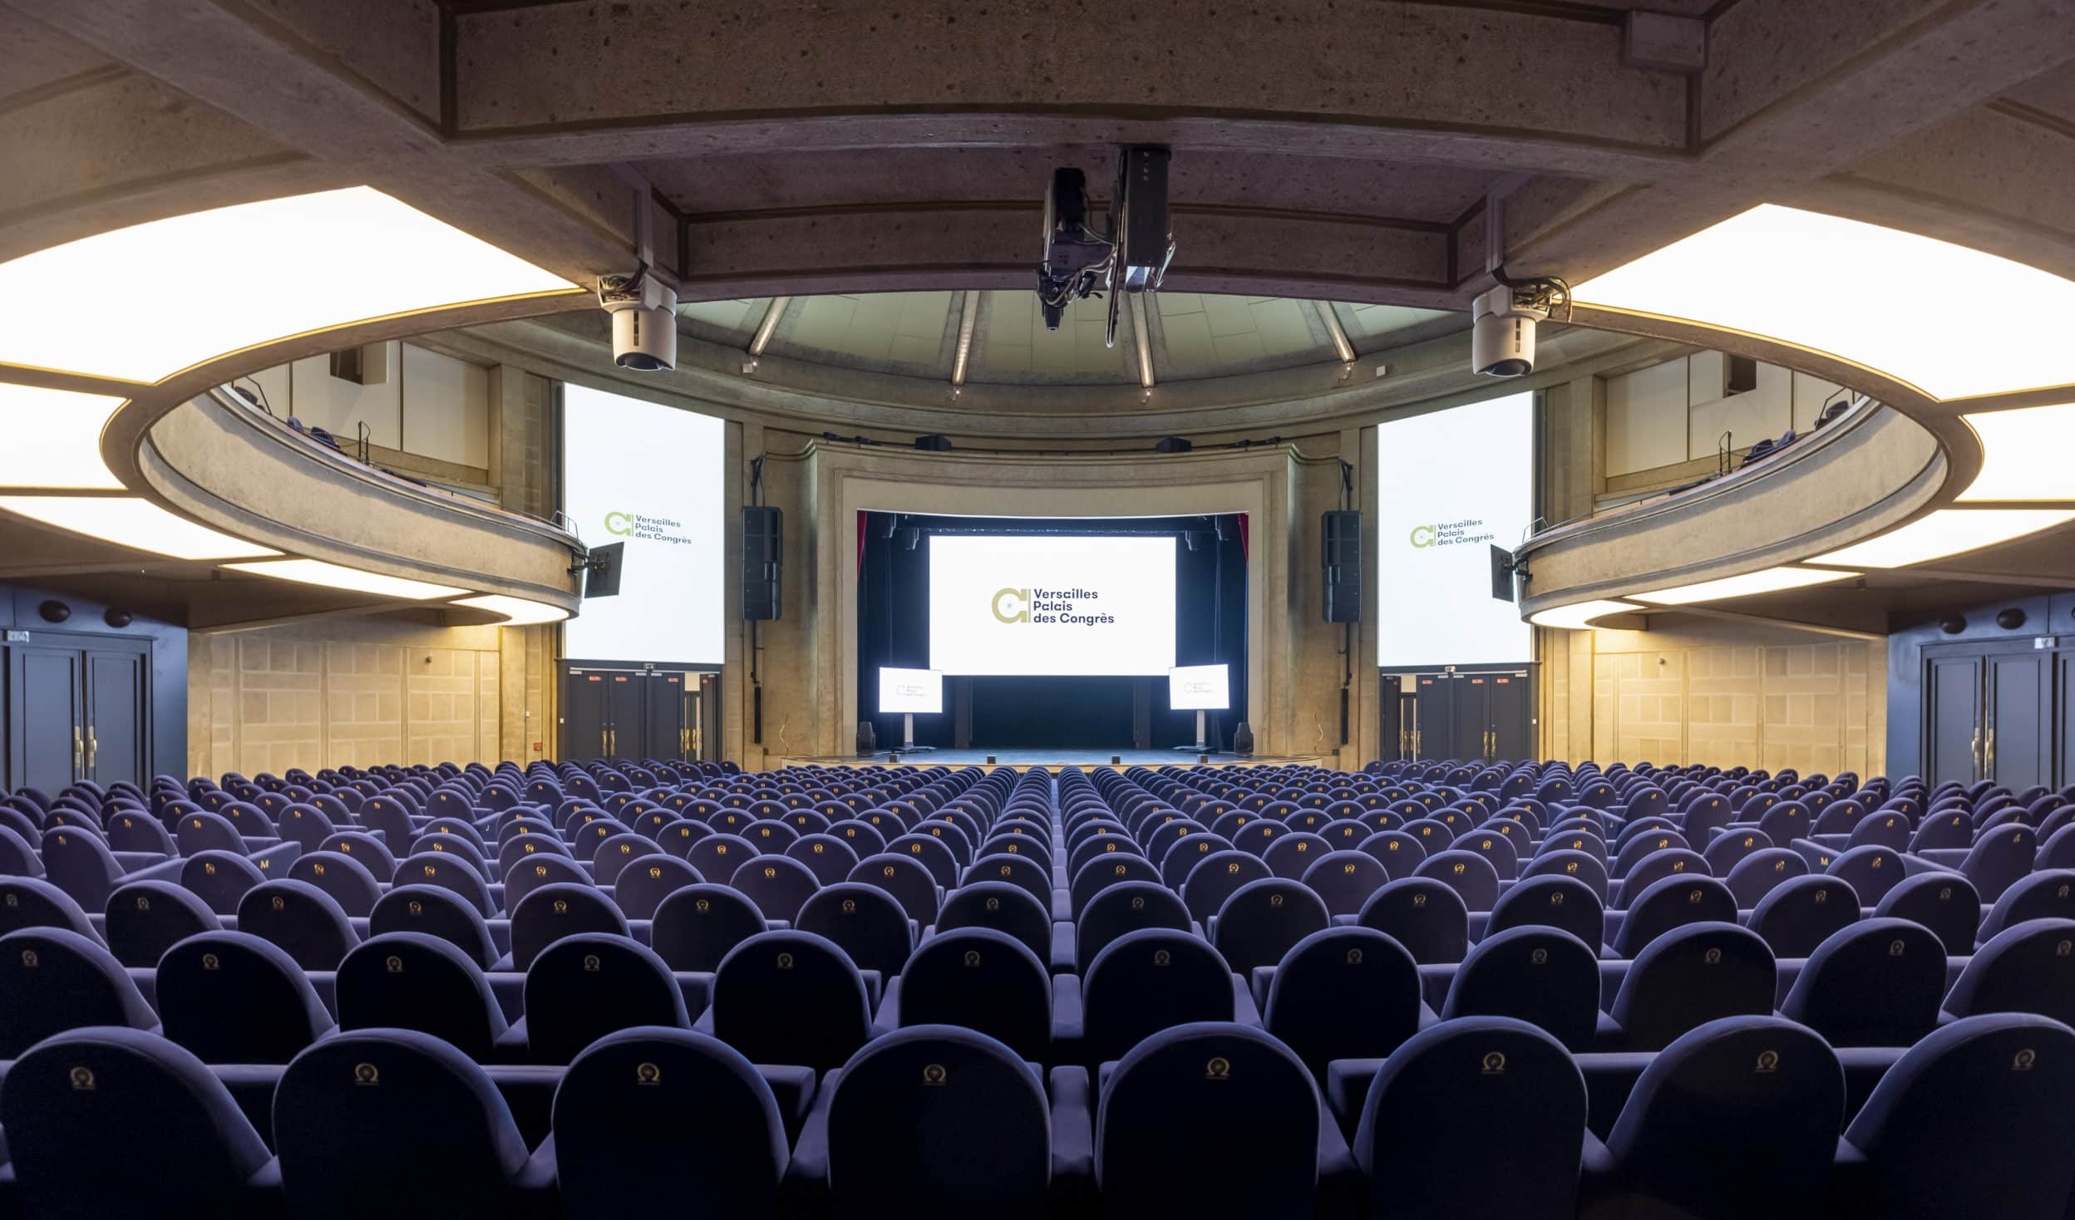
The conference venue
ICOS Science Conference 2024 will be hosted in Palais des Congrès, a newly-renovated event space situated across from the historical Château de Versailles, France.
Versailles is located close to Paris, meaning a host of public transport options are available.
For more information on transportation & accommodation, visit the website: icos-ri.eu/sc24

Slide 6
Side events & excursions
During the conference week, we will be hosting a variety of insightful side events and excursions.
Follow our website and social media to stay updated.

Slide 7
Hope to see you at #ICOS2024SC!
Website: icos-ri.eu/sc24
Newsletter: icos-ri.eu/news-and-events/newsletters
Social media
X (formerly Twitter): @ICOS_RI
LinkedIn: Integrated Carbon Observation System (ICOS)
Instagram: ICOSRI
Conctact email: conference@icos-ri.eu

